Slide 1
Conducting Iblagh-e-Deen activities in Kachi Bastees
Al-Huda Outreach Programs

Slide 2
کیوں؟

Slide 3
Steps
What is your objective?
Survey
Build Report
Team Preparation
Plan Strategy
Resource Collection
مقصد کیاہے؟
پہلا سروے
رپورٹ کی تیّاری
افراد کی تیّاری
لاحائہ عمل
درکار وسائل

Slide 4
مقصد کیاہے؟ What is your objective?

Slide 5
Survey پہلا سروے
Selection of Location
Best time to visit
Meeting with Locals
Identify Problems
How to take pictures
جگہ کا تعین
بہترین وقت
مقامی لوگوں سے ملاقات
مسائل کا تعین
تصاویر کیسے لیں

Slide 6
Survey پہلا سروے
Selection of Location
Home of a local person
Open ground
School building etc.
جگہ کا تعین
مقامی فرد کا گھر
میدان
سکول وغیرہ

Slide 7
Survey پہلا سروے
Best time to visit
Male members not at home
Ladies not busy in work
Children are present
بہترین وقت
جب مرد گھر میں نہ ہوں
خواتین کاموں میں مصروف نہ ہوں۔
بچے موجود ہوں۔

Slide 8
Survey پہلا سروے
Meeting with Locals
No theoretical talks
What they relate to
Don’t discuss problems
What they do daily
Take interest in their life
مقامی لوگوں سے ملاقات
ثقیل باتیں نہ ہوں
ان کے متعلق بات ہو
زیادہ مسائل کا تذکرہ نہیں
روزمرہ کاموں کے بارے میں بات کریں
انکی ذندگی میں شوق

Slide 9
Survey پہلا سروے
Identify Problems
By what you see
The situation around
Conclude from local peoples discussion
Health, Hygiene, Education etc.
مسائل کا تعین
دیکھنے سے
ماحول
مقامی لوگوں کی باتوں سے اخذ کریں
صحت، صفائی، تعلیم

Slide 10
Survey پہلا سروے
How to take pictures
Don’t make a pose and take a facial snap
Show some activitiy
Problems are seen visually
The picture tells a story
تصاویر کیسے لیں
چہرے نہ ہوں
کام دکھائیں
مسائل نظر آئیں
تصویر کہانی بیان کرے

Slide 11
Build Report رپورٹ کی تیّاری
Pictorial
Short description
Location
Date and Time of survey
Names / Contacts of people doing survey
Your reflections
Problems identified
Solutions proposed
تصویری
مختصر جائزہ
جگہ، وقت اور تاریخ
سروے کرنے والوں کے نام
آپکی رائے اور احساسات
مسائل
انکا حل

Slide 12
افراد کی تیّاریTeam Preparation
Dedicated
Committed on Regular basis
Identify roles
Set a meeting time
Who will do what
ایک بار کام کا آغاز کر کے اسکو جاری رکھنے والے ہوں
کون کیا کرے گا
ملاقات

Slide 13
لاحائہ عمل Plan Strategy
Kids class
Nazra
Ladies Dars
Cleanliness program
Health and Hygene
Cassette program
School
بچوں کی کلاس
ناظرہ
عورتوں کا درس
صفائی پروگرام
صحت عامہ
کیسٹ پروگرام
سکول

Slide 14
درکار وسائل Resource Collection
What do you need?
Transport
Books
Worksheets
Clothes
Food
Ration
کیا کچھ درکار ہے؟
خود کفیل ہو جائیں
مل کر طے کریں
کسی سے مانگنا نہیں!

Slide 15
کیا نہیں کرنا What not to do
Buying or taking a place inside the Kachi basti
Unplanned Food distribution
Going alone
Short term plan
کرایہ پر یا جگہ خرید لینا کچی بستی میں۔
بغیر پلاننگ تقسیم راشن یا کھانا
اکیلے جانا
ایک دو مرتبہ چلے جانا

Slide 16
OSC School
Caring for the Uncared
A true story

Slide 17
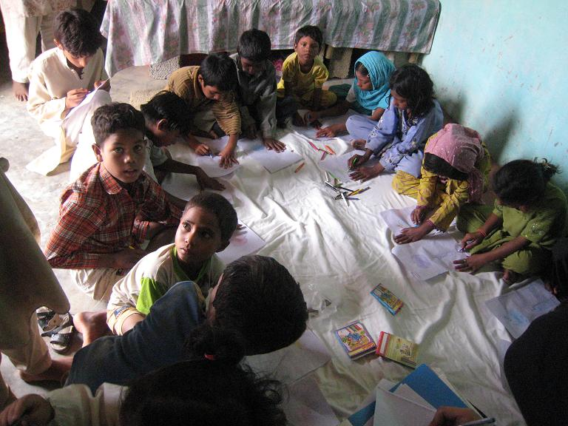
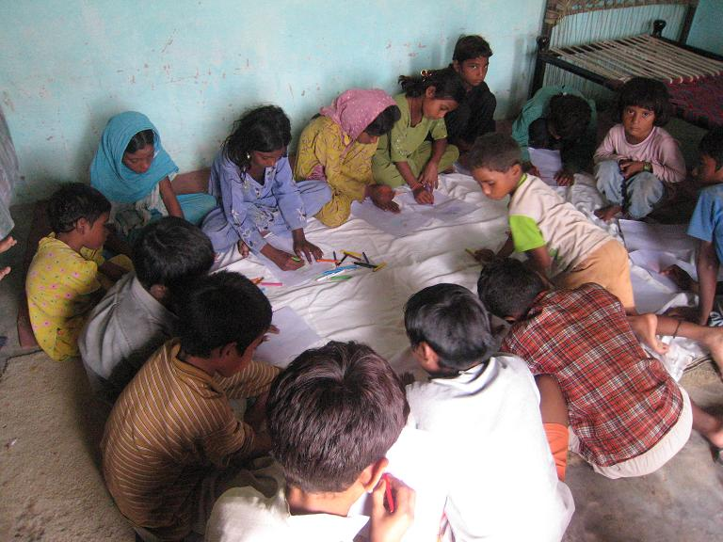
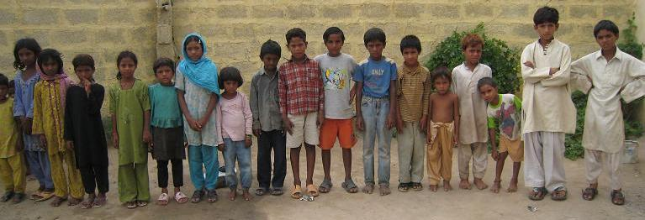
Our First Class September 2007
Doing Wudu
Coloring activity going on
Lined up
for a
Race
competition

Slide 18
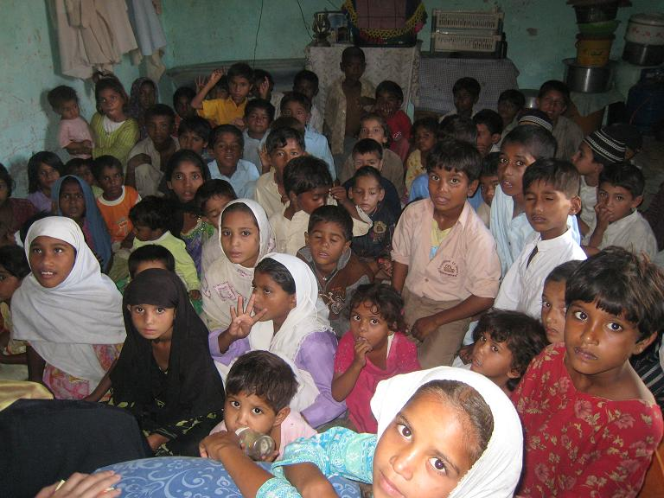
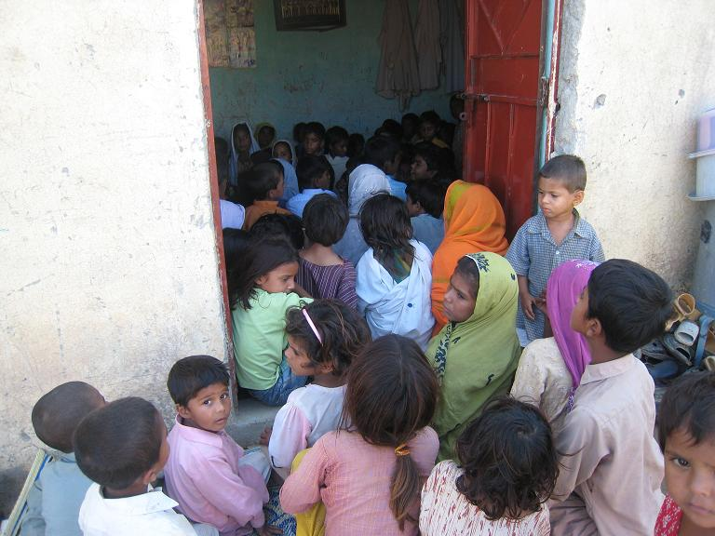
Number of children grew…

Slide 19
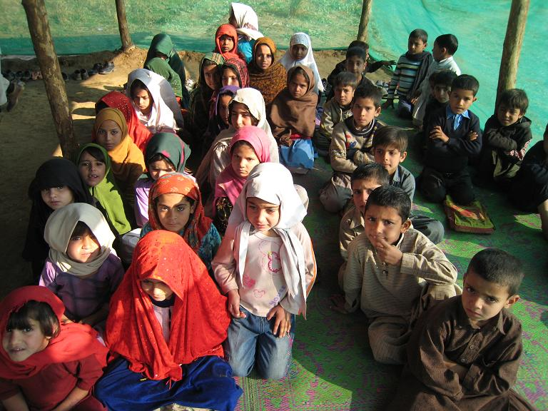
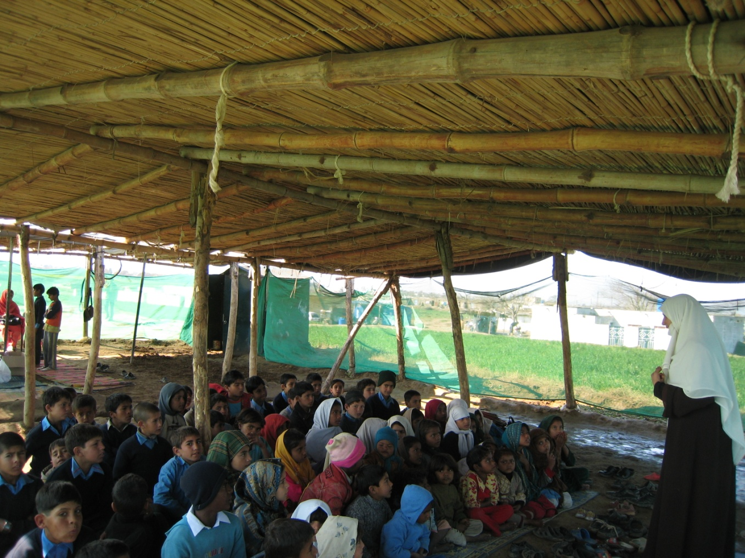
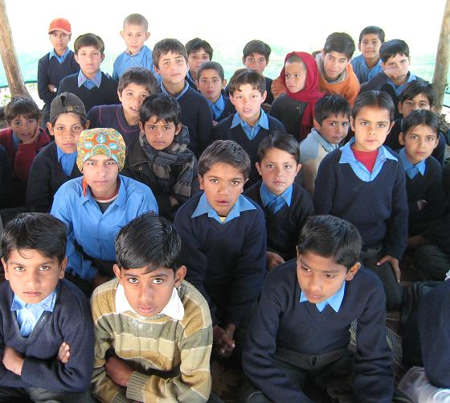
New Class in kachi basti School
Another class started…

Slide 20
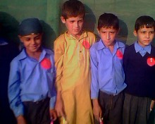
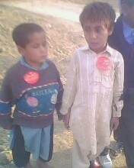
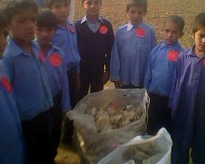
Community Cleaning
Volunteers : Alhuda Students
Group Competition held
Plastic bags from the vicinity collected
Young cleaners
Winners of competition

Slide 21
Eid in Kachi basti
Students from ZABIST and FAST
contributed
Eid gifts for nearly
200 children
became possible

Slide 22
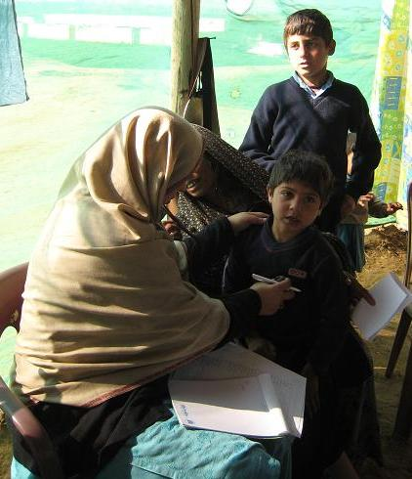
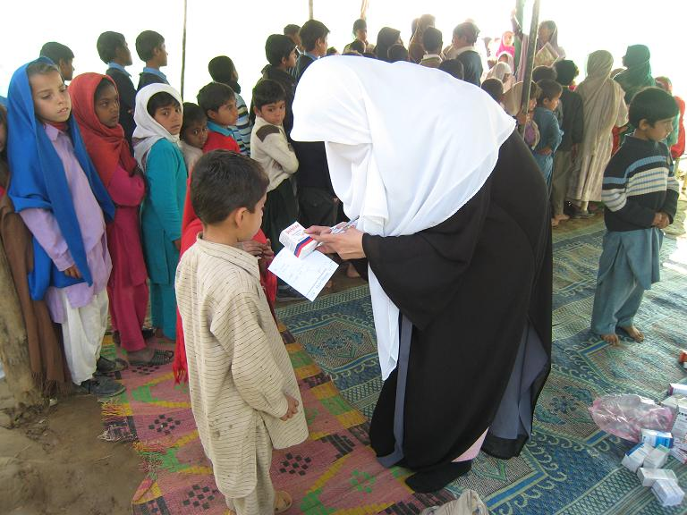
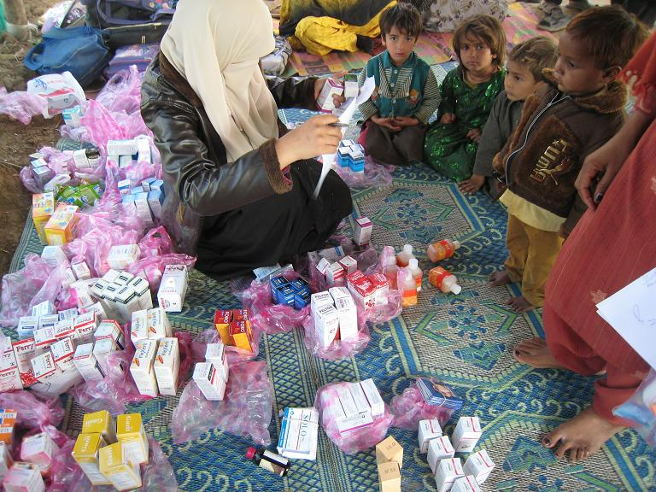
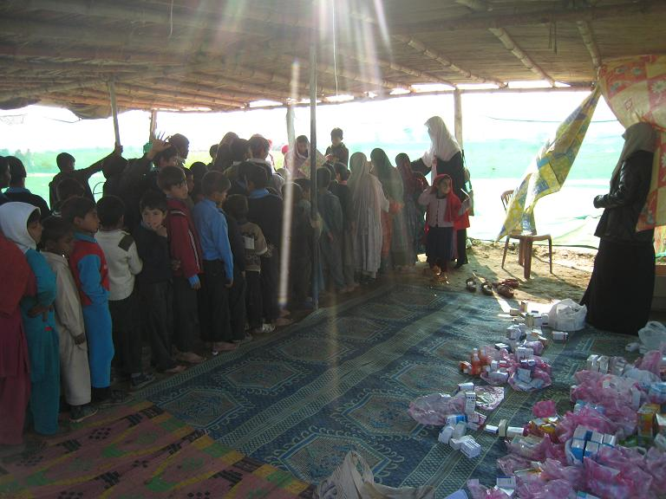
Free Medical Camp
Examination
in progress

Slide 23
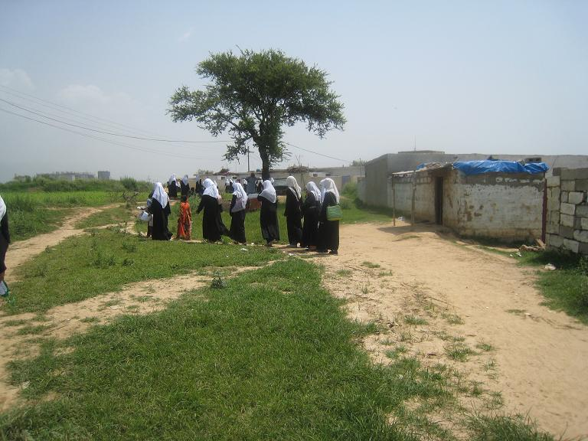
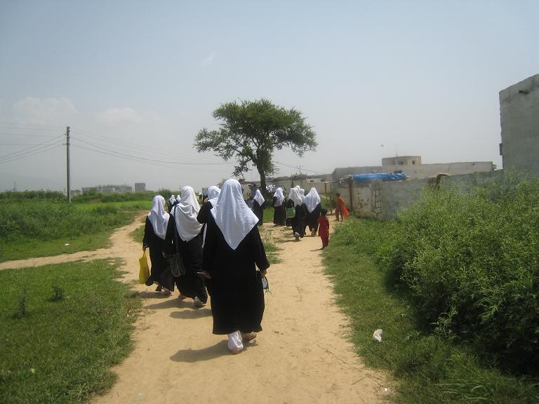
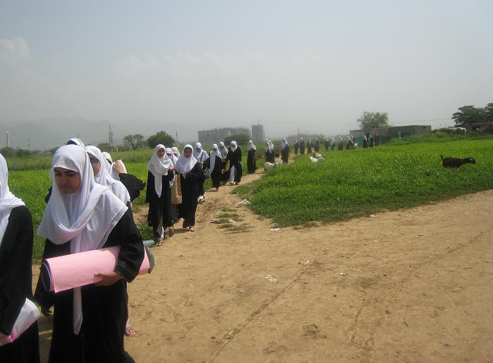
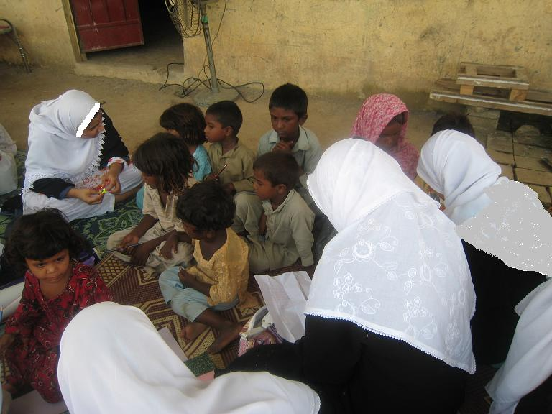
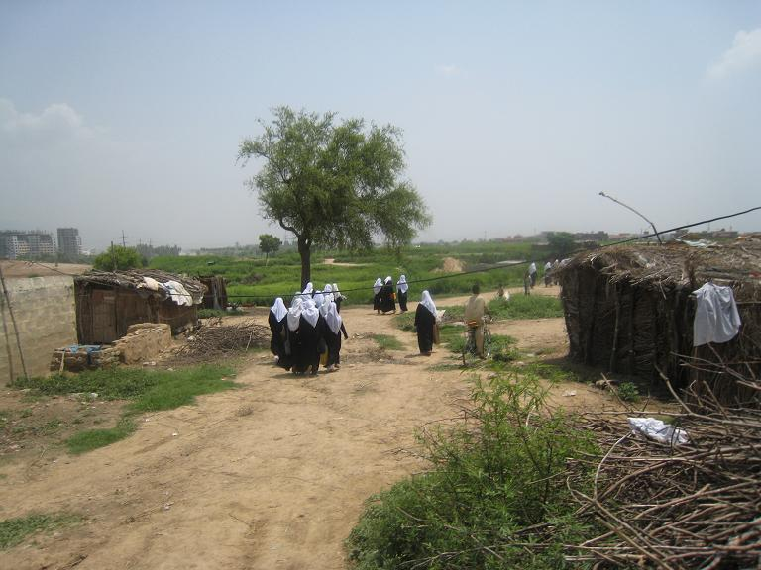
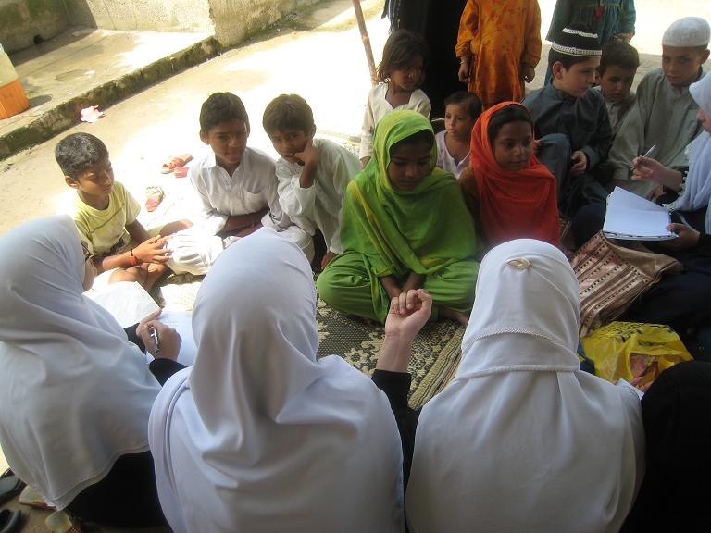
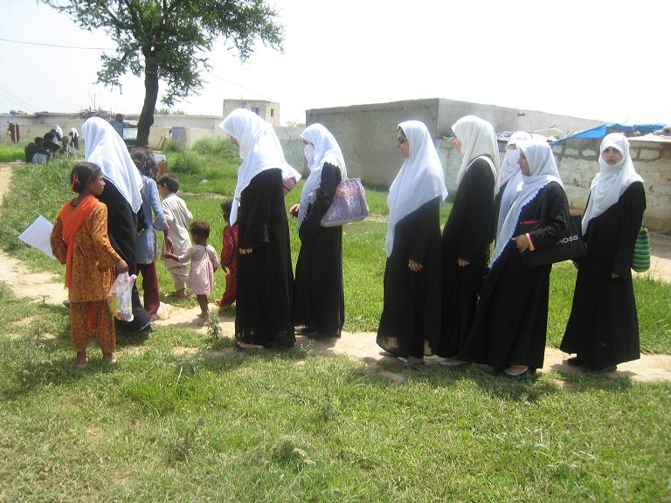
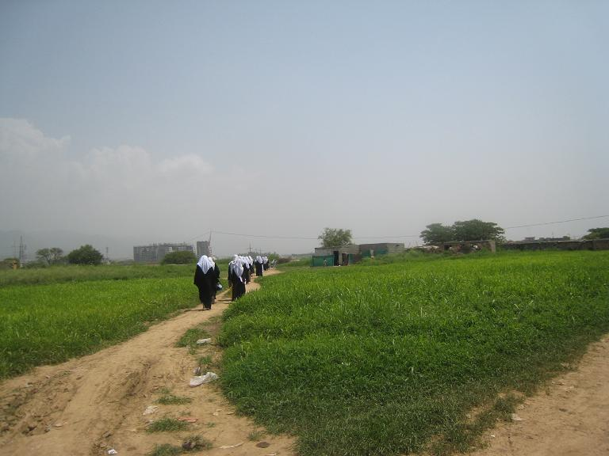
Reality touch visits Kachi Basti

Slide 24
Major Issues
Reaching class was one big task itself
Rainy days meant no class… you can’t imagine the mud and water pools
Once a week.... What can we do in so little time?
These children MUST at least learn to read and write

Slide 25
Why not open our own school?

Slide 26
Started Planning ….
But we were very scared….
How will we open up a school?
Who will fund it?
Is anyone going to come to our school?
Who will teach?
Where will the school be?
Ok …so you understand how lost we were ! ☺

Slide 27
Allah sends help

Slide 28
We have a School today!
A school specially for those who can not afford to go to school
Out of School Children’s School
OSC School

Slide 29
Out of School Children’s School 5 Branches AlhamdoliAllah
More than 40 staff members
Over 300 children
In 5 different ventures

Slide 30
Out of School Children School
An initiative to educate those for whom very few people care for.
To provide free quality education to deserving children
Who never had the opportunity to go to school.

Slide 31
At OSCS
Children given primary education in a short duration
Prepared to enter main stream education
Inculcating high level of moral and ethical values.

Slide 32
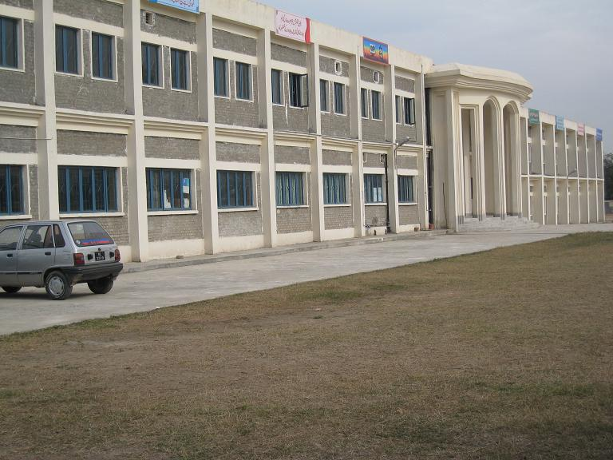
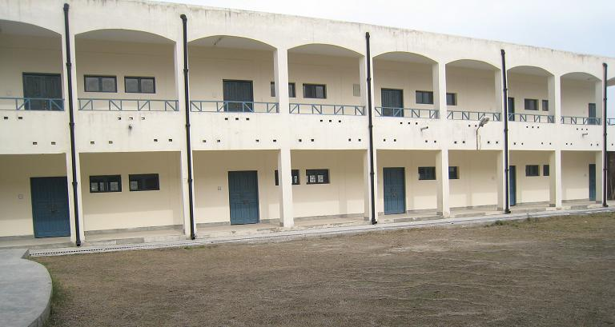
F-11 Branch
Inside F.G. Model School for girls
Our School
OSCS

Slide 33
First class of 2009

Slide 34
H- 9 Branch
Collaboration with
National Child Protection Center
NCP
Started in Summers of 2012

Slide 35
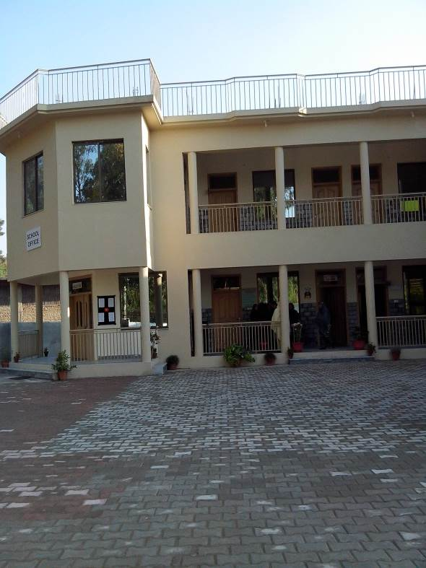
Tarnol Branch
Collaboration with
Abrar Foundation
Started – 1st Oct 2012

Slide 36
On a smaller scale Lahore DHA and New Lalazar Branches

